Slide 1
CS4961 Parallel Programming Chapter 5 Introduction to SIMD Johnnie Baker January 14, 2011

Slide 2
Chapter Sources
J. Baker, Chapters 1-2 slides from Fall 2010 class in Parallel & Distributed Programming, Kent State University
Mary Hall, Slides from Lectures 7-8 for CS4961, University of Utah.
Michael Quinn, Parallel Programming in C with MPI and OpenMP, 2004, McGraw Hill.

Slide 3
Some Definitions
Concurrent - Events or processes which seem to occur or progress at the same time.
Parallel –Events or processes which occur or progress at the same time
Parallel programming (also, unfortunately, sometimes called concurrent programming), is a computer programming technique that provides for the parallel execution of operations , either
within a single parallel computer
or across a number of systems.
In the latter case, the term distributed computing is used.

Slide 4
Flynn’s Taxonomy (Section 2.6 in Quinn’s Textbook)
Best known classification scheme for parallel computers.
Depends on parallelism it exhibits with its
Instruction stream
Data stream
A sequence of instructions (the instruction stream) manipulates a sequence of operands (the data stream)
The instruction stream (I) and the data stream (D) can be either single (S) or multiple (M)
Four combinations: SISD, SIMD, MISD, MIMD

Slide 5
SISD
Single Instruction, Single Data
Single-CPU systems
i.e., uniprocessors
Note: co-processors don’t count as additional processors
Concurrent processing allowed
Instruction prefetching
Pipelined execution of instructions
Concurrent execution allowed
That is, independent concurrent tasks can execute different sequences of operations.
Functional parallelism is discussed in later slides in Ch. 1
E.g., I/O controllers are independent of CPU
Most Important Example: a PC

Slide 6
SIMD
Single instruction, multiple data
One instruction stream is broadcast to all processors
Each processor, also called a processing element (or PE), is usually simplistic and logically is essentially an ALU;
PEs do not store a copy of the program nor have a program control unit.
Individual processors can remain idle during execution of segments of the program (based on a data test).

Slide 7
SIMD (cont.)
All active processor executes the same instruction synchronously, but on different data
Technically, on a memory access, all active processors must access the same location in their local memory.
This requirement is sometimes relaxed a bit.
The data items form an array (or vector) and an instruction can act on the complete array in one cycle.

Slide 8
SIMD (cont.)
Quinn also calls this architecture a processor array. Some examples include
ILLIAC IV (1974) was the first SIMD computer
The STARAN and MPP (Dr. Batcher architect)
Connection Machine CM2, built by Thinking Machines).
MasPar (for Massively Parallel) computers.

Slide 9
How to View a SIMD Machine
Think of soldiers all in a unit.
The commander selects certain soldiers as active – for example, the first row.
The commander barks out an order to all the active soldiers, who execute the order synchronously.
The remaining soldiers do not execute orders until they are re-activated.

Slide 10
MISD
Multiple instruction streams, single data stream
This category does not receive much attention from most authors, so it will only be mentioned on this slide.
Quinn argues that a systolic array is an example of a MISD structure (pg 55-57)
Some authors include pipelined architecture in this category

Slide 11
MIMD
Multiple instruction, multiple data
Processors are asynchronous, since they can independently execute different programs on different data sets.
Communications are handled either
through shared memory. (multiprocessors)
by use of message passing (multicomputers)
MIMD’s have been considered by most researchers to include the most powerful and least restricted computers.

Slide 12
MIMD (cont. 2/4)
Have very major communication costs
When compared to SIMDs
Internal ‘housekeeping activities’ are often overlooked
Maintaining distributed memory & distributed databases
Synchronization or scheduling of tasks
Load balancing between processors
One method for programming MIMDs is for all processors to execute the same program.
Execution of tasks by processors is still asynchronous
Called SPMD method (single program, multiple data)
Usual method when number of processors are large.
Considered to be a “data parallel programming” style for MIMDs.

Slide 13
MIMD (cont 3/4)
A more common technique for programming MIMDs is to use multi-tasking:
The problem solution is broken up into various tasks.
Tasks are distributed among processors initially.
If new tasks are produced during executions, these may handled by parent processor or distributed
Each processor can execute its collection of tasks concurrently.
If some of its tasks must wait for results from other tasks or new data , the processor will focus the remaining tasks.
Larger programs usually run a load balancing algorithm in the background that re-distributes the tasks assigned to the processors during execution
Either dynamic load balancing or called at specific times
Dynamic scheduling algorithms may be needed to assign a higher execution priority to time-critical tasks
E.g., on critical path, more important, earlier deadline, etc.

Slide 14
MIMD (cont 4/4)
Recall, there are two principle types of MIMD computers:
Multiprocessors (with shared memory)
Multicomputers
Both are important and are covered next in greater detail.

Slide 15
Multiprocessors (Shared Memory MIMDs)
All processors have access to all memory locations .
Two types: UMA and NUMA
UMA (uniform memory access)
Frequently called symmetric multiprocessors or SMPs
Similar to uniprocessor, except additional, identical CPU’s are added to the bus.
Each processor has equal access to memory and can do anything that any other processor can do.
SMPs have been and remain very popular

Slide 16
Multiprocessors (cont.)
NUMA (non-uniform memory access).
Has a distributed memory system.
Each memory location has the same address for all processors.
Access time to a given memory location varies considerably for different CPUs.
Normally, fast cache is used with NUMA systems to reduce the problem of different memory access time for PEs.
Creates problem of ensuring all copies of the same data in different memory locations are identical.

Slide 17
Multicomputers (Message-Passing MIMDs)
Processors are connected by a network
Interconnection network connections is one possibility
Also, may be connected by Ethernet links or a bus.
Each processor has a local memory and can only access its own local memory.
Data is passed between processors using messages, when specified by the program.
Message passing between processors is controlled by a message passing language (typically MPI)
The problem is divided into processes or tasks that can be executed concurrently on individual processors. Each processor is normally assigned multiple processes.

Slide 18
Multiprocessors vs Multicomputers
Programming disadvantages of message-passing
Programmers must make explicit message-passing calls in the code
This is low-level programming and is error prone.
Data is not shared between processors but copied, which increases the total data size.
Data integrity problem: Difficulty to maintain correctness of multiple copies of data item.

Slide 19
Multiprocessors vs Multicomputers (cont)
Programming advantages of message-passing
No problem with simultaneous access to data.
Allows different PCs to operate on the same data independently.
Allows PCs on a network to be easily upgraded when faster processors become available.
Mixed “distributed shared memory” systems exist
Lots of current interest in a cluster of SMPs.
Easier to build systems with a very large number of processors.

Slide 20
Seeking Concurrency Several Different Ways Exist
Data dependence graphs
Data parallelism
Task parallelism
Sometimes called control parallelism or functional parallelism.
Pipelining

Slide 21
Data Dependence Graph
Directed graph
Vertices = tasks
Edges = dependences
Edge from u to v means that task u must finish before task v can start.

Slide 22
Data Parallelism
All tasks (or processors) apply the same set of operations to different data.
Example:
Operations may be executed concurrently
Accomplished on SIMDs by having all active processors execute the operations synchronously.
Can be accomplished on MIMDs by assigning 100/p tasks to each processor and having each processor to calculated its share asynchronously.
for i ← 0 to 99 do
a[i] ← b[i] + c[i]
endfor

Slide 23
Supporting MIMD Data Parallelism
SPMD (single program, multiple data) programming is generally considered to be data parallel.
Note SPMD could allow processors to execute different sections of the program concurrently
A way to more strictly enforce a SIMD-type data parallel programming using SPMP programming is as follows:
Processors execute the same block of instructions concurrently but asynchronously
No communication or synchronization occurs within these concurrent instruction blocks.
Each instruction block is normally followed by a synchronization and communication block of steps
If processors have multiple identical tasks, the preceding method can be generalized using virtual parallelism.
Virtual Parallelism is where each processor of a parallel processor plays the role of several processors.

Slide 24
Data Parallelism Features
Each processor performs the same data computation on different data sets
Computations can be performed either synchronously or asynchronously
Defn: Grain Size is the average number of computations performed between communication or synchronization steps
See Quinn textbook, page 411
Data parallel programming usually results in smaller grain size computation
SIMD computation is considered to be fine-grain
MIMD data parallelism is usually considered to be medium grain
MIMD multi-tasking is considered to be course grain

Slide 25
Task/Functional/Control/Job Parallelism
Independent tasks apply different operations to different data elements
First and second statements may execute concurrently
Third and fourth statements may execute concurrently
Normally, this type of parallelism deals with concurrent execution of tasks, not statements
a ← 2
b ← 3
m ← (a + b) / 2
s ← (a² + b²) / 2
v ← s - m²

Slide 26
Control Parallelism Features
Problem is divided into different non-identical tasks
Tasks are divided between the processors so that their workload is roughly balanced
Parallelism at the task level is considered to be coarse grained parallelism

Slide 27
Data Dependence Graph
Can be used to identify data parallelism and job parallelism.
See page 11 of textbook.
Most realistic jobs contain both parallelisms
Can be viewed as branches in data parallel tasks
If no path from vertex u to vertex v, then job parallelism can be used to execute the tasks u and v concurrently.
- If larger tasks can be subdivided into smaller identical tasks, data parallelism can be used to execute these concurrently.

Slide 28
For example, “mow lawn” becomes
Mow N lawn
Mow S lawn
Mow E lawn
Mow W lawn
If 4 people are available
to mow, then data parallelism
can be used to do these
tasks simultaneously.
Similarly, if several people
are available to “edge lawn”
and “weed garden”, then we
can use data parallelism to
provide more concurrency.

Slide 29
Pipelining
Divide a process into stages
Produce several items simultaneously

Slide 30
Compute Partial Sums
Consider the for loop:
p[0] ← a[0]
for i ← 1 to 3 do
p[i] ← p[i-1] + a[i]
endfor
This computes the partial sums:
p[0] ← a[0]
p[1] ← a[0] + a[1]
p[2] ← a[0] + a[1] + a[2]
p[3] ← a[0] + a[1] + a[2] + a[3]
The loop is not data parallel as there are dependencies.
However, we can stage the calculations in order to achieve some parallelism.

Slide 31
Partial Sums Pipeline

Slide 32
Alternate Names for SIMDs
Recall that all active processors of a true SIMD computer must simultaneously access the same memory location.
The value in the i-th processor can be viewed as the i-th component of a vector.
SIMD machines are sometimes called vector computers [Jordan,et.al.] or processor arrays [Quinn 94,04] based on their ability to execute vector and matrix operations efficiently.

Slide 33
SIMD Computers
SIMD computers that focus on vector operations
Support some vector and possibly matrix operations in hardware
Usually limit or provide less support for non-vector type operations involving data in the “vector components”.
General purpose SIMD computers
May also provide some vector and possibly matrix operations in hardware.
More support for traditional type operations (e.g., other than for vector/matrix data types).

Slide 34
Why Processor Arrays?
Historically, high cost of control units
Scientific applications have data parallelism

Slide 35
Data/instruction Storage
Front end computer
Also called the control unit
Holds and runs program
Data manipulated sequentially
Processor array
Data manipulated in parallel

Slide 36
Processor Array Performance
Performance: work done per time unit
Performance of processor array
Speed of processing elements
Utilization of processing elements

Slide 37
Performance Example 1
1024 processors
Each adds a pair of integers in 1 μsec (1 microsecond or one millionth of second or
10⁻⁶ second.)
What is the performance when adding two 1024-element vectors (one per processor)?

Slide 38

Performance Example 2
512 processors
Each adds two integers in 1 μsec
What is the performance when adding two vectors of length 600?
Since 600 > 512, 88 processor must add two pairs of integers.
The other 424 processors add only a single pair of integers.

Slide 39
Example of a 2-D Processor Interconnection Network in a Processor Array
Each VLSI chip has 16 processing elements.
Each PE can simultaneously send a value to a neighbor.
PE = processor element

Slide 40
SIMD Execution Style
The traditional (SIMD, vector, processor array) execution style ([Quinn 94, pg 62], [Quinn 2004, pgs 37-43]:
The sequential processor that broadcasts the commands to the rest of the processors is called the front end or control unit (or sometimes host).
The front end is a general purpose CPU that stores the program and the data that is not manipulated in parallel.
The front end normally executes the sequential portions of the program.
Alternately, all PEs needing computation can execute computation steps synchronously in order to avoid broadcast cost to distribute results
Each processing element has a local memory that cannot be directly accessed by the control unit or other processing elements.

Slide 41
SIMD Execution Style
Collectively, the individual memories of the processing elements (PEs) store the (vector) data that is processed in parallel.
When the front end encounters an instruction whose operand is a vector, it issues a command to the PEs to perform the instruction in parallel.
Although the PEs execute in parallel, some units can be allowed to skip particular instructions.

Slide 42
Masking on Processor Arrays
All the processors work in lockstep except those that are masked out (by setting mask register).
The conditional if-then-else is different for processor arrays than sequential version
Every active processor tests to see if its data meets the negation of the boolean condition.
If it does, it sets its mask bit so those processors will not participate in the operation initially.
Next the unmasked processors, execute the THEN part.
Afterwards, mask bits (for original set of active processors) are flipped and unmasked processors perform the the ELSE part.

Slide 43
if (COND) then A else B

Slide 44
if (COND) then A else B

Slide 45
if (COND) then A else B

Slide 46
SIMD Machines
An early SIMD computer designed for vector and matrix processing was the Illiac IV computer
Initial development at the University of Illinois 1965-70
Moved to NASA Ames, completed in 1972 but not fully functional until 1976.
See Jordan et. al., pg 7 and Wikepedia
The MPP, DAP, the Connection Machines CM-1 and CM-2, and MasPar’s MP-1 and MP-2 are examples of SIMD computers
See Akl pg 8-12 and [Quinn, 94]
The CRAY-1 and the Cyber-205 use pipelined arithmetic units to support vector operations and are sometimes called a pipelined SIMD
See [Jordan, et al, p7], [Quinn 94, pg 61-2], and [Quinn 2004, pg37).

Slide 47
SIMD Machines
Quinn [1994, pg 63-67] discusses the CM-2 Connection Machine (with 64K PEs) and a smaller & updated CM-200.
Professor Batcher was the chief architect for the STARAN (early 1970’s) and the MPP (Massively Parallel Processor, early 1980’s) and an advisor for the ASPRO
STARAN was built to do air traffic control (ATC), a real-time application
ASPRO is a small second generation STARAN used by the Navy in the spy planes for air defense systems, a related area to ATC.
MPP was ordered by NASA-Goddard, in DC area and was used for multiple scientific computations.
Professor Batcher is best known architecturally for the MPP, which is at the Smithsonian Institute & currently displayed at a D.C. airport.

Slide 48
Today’s SIMDs
SIMD functionality is sometimes embedded in sequential machines.
Others are being build as part of hybrid architectures.
Some SIMD and SIMD-like features are included in some multi/many core processing units
Some SIMD-like architectures have been build as special purpose machines, although some of these could classify as general purpose.
Some of this work has been proprietary.
The fact that a parallel computer is SIMD or SIMD-like is often not advertised by the company building them.

Slide 49
An Inexpensive SIMD
ClearSpeed produced a COTS (commodity off the shelf) SIMD Board
WorldScape has developed some defense and commercial applications for this computer.
Not a traditional SIMD as the hardware doesn’t tightly synchronize the execution of instructions.
Hardware design supports efficient synchronization
This machine is programmed like a SIMD.
The U.S. Navy observed that ClearSpeed machines process radar a magnitude faster than others.
Earlier, quite a bit of information about this was at the websites www.wscape.com and www.clearspeed.com
I have a lot of ClearSpeed information posted at www.cs.kent.edu/~jbaker/ClearSpeed/
Must log in from a “cs.kent.edu” account in order to be able to gain access using login-name and password.

Slide 50
Advantages of SIMDs
Reference: [Roosta, pg 10]
Less hardware than MIMDs as they have only one control unit.
Control units are complex.
Less memory needed than MIMD
Only one copy of the instructions need to be stored
Allows more data to be stored in memory.
Much less time required for communication between PEs and data movement.

Slide 51
Advantages of SIMDs (cont)
Single instruction stream and synchronization of PEs make SIMD applications easier to program, understand, & debug.
Similar to sequential programming
Control flow operations and scalar operations can be executed on the control unit while PEs are executing other instructions.
MIMD architectures require explicit synchronization primitives, which create a substantial amount of additional overhead.

Slide 52
Advantages of SIMDs (cont)
During a communication operation between PEs,
PEs send data to a neighboring PE in parallel and in lock step
No need to create a header with routing information as “routing” is determined by program steps.
the entire communication operation is executed synchronously
SIMDs are deterministic & have much more predictable running time.
Can normally compute a tight, worst case upper bound for the time required for both computation & communications operations.
Less complex hardware in SIMD since no message decoder is needed in the PEs
MIMDs need a message decoder in each PE.

Slide 53
We next consider the usual claims about SIMD shortcomings
Since SIMDs are not well-understood by most computer science professionals today, it is important that we examine these carefully. Also, due to rapid changes that occur regularly in computational science, some concerns may become either more relevant or less relevant over time.

Slide 54
SIMD Shortcoming Claims (with some rebuttals -- 1/7)
Claims are from Quinn’s textbook [i.e., Quinn 2004].
Similar statements are found in [Grama, et. al].
Claim 1: SIMDs have a data-parallel orientation, but not all problems are data-parallel
While not all solutions are data parallel, most problems seem to have a data parallel solution.
In [Fox, et.al.], the observation was made in their study of large parallel applications at national labs, that most were data parallel by nature, but often had points where significant branching occurred.

Slide 55
SIMD Shortcoming Claims (with some rebuttals – 2/7)
Claim 2: Speed drops for conditionally executed branches
MIMDs processors can execute multiple branches concurrently.
For an if-then-else statement with execution times for the “then” and “else” parts being roughly equal, about ½ of the SIMD processors are idle during its execution
With additional branching, the average number of inactive processors can become even higher.
With SIMDs, only one of these branches can be executed at a time.
Note that this reason justifies the study of multiple SIMDs (or MSIMDs), which can reduce or eliminate branching
On many applications, any branching is quite shallow.

Slide 56
SIMD Shortcoming Claims (with some rebuttals – 3/7)
Claim 2 (cont): Speed drops for conditionally executed code
In [Fox, et.al.], the observation was made that for the real applications surveyed, the MAXIMUM number of active branches at any point in time was about 8.
The cost of the simple processors used in a SIMD is small, so the cost of multiple simple processors being idle may be less important than the increase in running time.
Programmers used to worry about ‘full utilization of memory’ but stopped this after memory cost became insignificant overall.
Often the much of the code in long THEN and ELSE parts is identical and the IF-THEN-ELSE construct can be replaced with multiple short IF-THEN-ELSE so that all processors can execute the identical code simultaneously.

Slide 57
SIMD Shortcoming Claims (with some rebuttals – 4/7)
Claim 3: Don’t adapt to multiple users well.
This is true to some degree for all parallel computers.
If usage of a parallel processor is dedicated to a important problem, it is probably best not to risk compromising its performance by ‘sharing’ its time with other applications
This reason also justifies the study of multiple SIMDs (or MSIMD).
SIMD architecture has not received the research and development attention that MIMD has received and can greatly benefit from further attention.

Slide 58
SIMD Shortcoming Claims (with some rebuttals -- 5/7)
Claim 4: Do not scale down well to “starter” systems that are affordable.
This point is arguable and its ‘truth’ is likely to vary rapidly over time
ClearSpeed produced several very economical SIMD boards that plugs into a PC with at least 48 processors per chip and 2-3 chips per board.

Slide 59
SIMD Shortcoming Claims (with some rebuttals -- 6/7)
Claim 5: Requires customized VLSI for processors and expense of control units in PCs has dropped.
Reliance on COTS (Commodity, off-the-shelf parts) has dramatically dropped the price of MIMDS over time.
Expense of PCs (with control units) has dropped significantly
However, reliance on COTS has fueled the success of a ‘low level parallelism’ provided by clusters and restricted new innovative parallel architecture research for well over a decade.

Slide 60
SIMD Shortcoming Claims (with some rebuttals – 7/7)
Claim 5 (cont.)
There is strong evidence that the period of continual dramatic increases in speed of PCs and clusters is ending.
Continued rapid increases in parallel performance in the future will be necessary in order to solve important problems that are beyond our current capabilities
Additionally, with the appearance of the very economical COTS SIMDs, this claim no longer appears to be relevant.

Slide 61
Switch here to looking at some of Mary Hall’s slides
Her focus is focused more on the occurrence of SIMD computations in some of the new GPGPS architectures

Slide 62
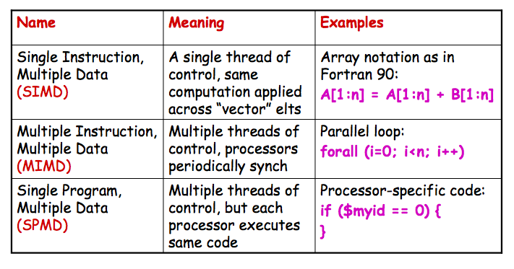
Review: Predominant Parallel Control Mechanisms

Slide 63
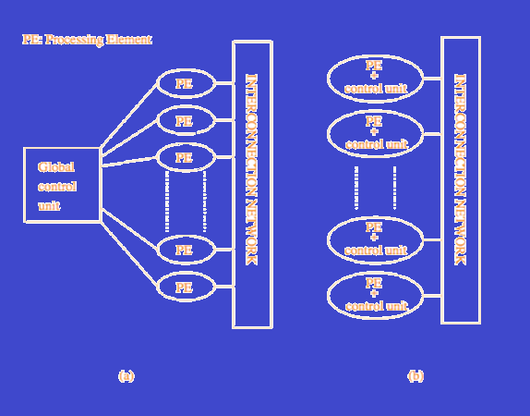
SIMD and MIMD Architectures: What’s the Difference?
A typical SIMD architecture and a typical MIMD architecture (b)
Slide source: Grama et al., Introduction to Parallel Computing, http://www.users.cs.umn.edu/~karypis/parbook

Slide 64
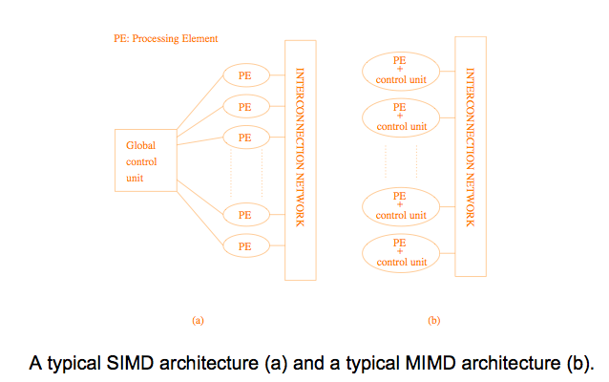
SIMD and MIMD Architectures: What’s the Difference?
Slide source: Grama et al., Introduction to Parallel Computing, http://www.users.cs.umn.edu/~karypis/parbook

Slide 65
Overview of SIMD Programming
Vector architectures
Early examples of SIMD supercomputers
TODAY Mostly
Multimedia extensions such as SSE and AltiVec
Graphics and games processors
Accelerators (e.g., ClearSpeed)
Is there a dominant SIMD programming model
Unfortunately, NO!!!
Why not?
Vector architectures were programmed by scientists
Multimedia extension architectures are programmed by systems programmers (almost assembly language!)
GPUs are programmed by games developers (domain- specific libraries)

Slide 66
Added Information
SSE
Streaming SIMD Extensions
A series of additional instructions built into the Pentium CPU
An earlier full-screen editor in OS/2
AltiVec
A floating point SIMD instruction set designed and owend by Apple Computer, IBM, and Motorola
The AIM alliance.

Slide 67
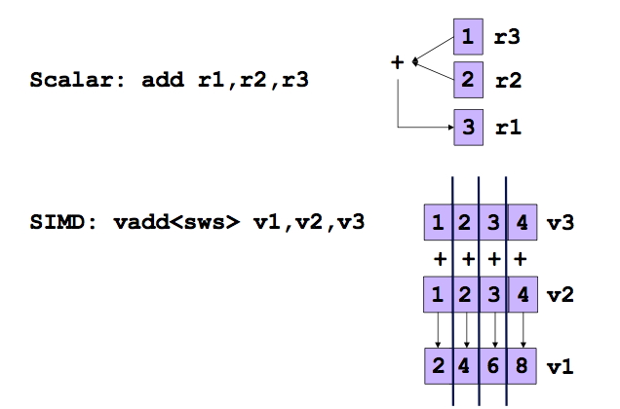
Scalar vs. SIMD in Multimedia Extensions

Slide 68
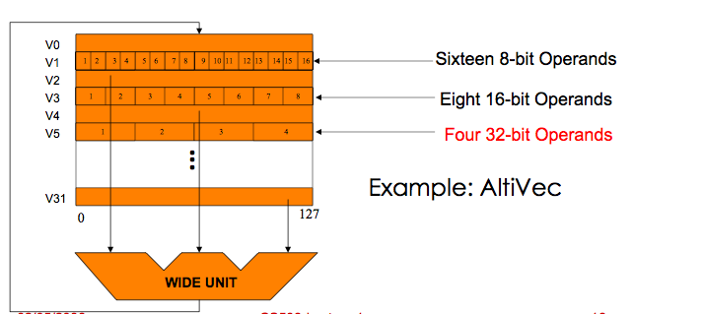
Multimedia Extension Architectures
At the core of multimedia extensions
SIMD parallelism
Variable-sized data fields:
Vector length = register width / type size

Slide 69
Multimedia / Scientific Applications
Image
Graphics : 3D games, movies
Image recognition
Video encoding/decoding : JPEG, MPEG4
Sound
Encoding/decoding: IP phone, MP3
Speech recognition
Digital signal processing: Cell phones
Scientific applications
Double precision Matrix-Matrix multiplication (DGEMM)
Y[] = a*X[] + Y[] (SAXPY)

Slide 70
Characteristics of Multimedia Applications
Regular data access pattern
Data items are contiguous in memory
Short data types
8, 16, 32 bits
Data streaming through a series of processing stages
Some temporal reuse for such data streams
Sometimes …
Many constants
Short iteration counts
Requires saturation arithmetic

Slide 71
Saturation Arithmetic
Saturation arithmetic is a version of arithmetic in which all operations such as addition and multiplication are limited to a fixed range between a minimum and maximum value. If the result of an operation is greater than the maximum it is set ("clamped") to the maximum, while if it is below the minimum it is clamped to the minimum. The name comes from how the value becomes "saturated" once it reaches the extreme values; further additions to a maximum or subtractions from a minimum will not change the result.
For example, if the valid range of values is from -100 to 100, the following operations produce the following values:
60 + 43 = 100
(60 + 43) − 150 = −50
43 − 150 = −100
60 + (43 − 150) = −40
10 × 11 = 100
99 × 99 = 100
30 × (5 − 1) = 100
30 × 5 − 30 × 1 = 70
As can be seen from these examples, familiar properties like associativity and distributivity fail in saturation arithmetic. This makes it unpleasant to deal with in abstract mathematics, but it has an important role to play in digital hardware and algorithms.
Typically, early computer microprocessors did not implement integer arithmetic operations using saturation arithmetic; instead, they used the easier-to-implement modular arithmetic, in which values exceeding the maximum value "wrap around" to the minimum value, like the hours on a clock passing

Slide 72
Why SIMD
More parallelism
When parallelism is abundant
SIMD in addition to ILP
instruction level parallelism)
Simple design
Replicated functional units
Small die area
No heavily ported register files
Die area: +MAX-2(HP): 0.1% +VIS(Sun): 3.0%
Must be explicitly exposed to the hardware
By the compiler or by the programmer

Slide 73
Programming Multimedia Extensions
Language extension
Programming interface similar to function call
C: built-in functions, Fortran: intrinsics
Most native compilers support their own multimedia extensions
GCC: -faltivec, -msse2
AltiVec: dst= vec_add(src1, src2);
SSE2: dst= _mm_add_ps(src1, src2);
BG/L: dst= __fpadd(src1, src2);
No Standard !
Need automatic compilation

Slide 74
Programming Complexity Issues
High level: Use compiler
may not always be successful
Low level: Use intrinsics or inline assembly tedious and error prone
Data must be aligned, and adjacent in memory
Unaligned data may produce incorrect results
May need to copy to get adjacency (overhead)
Control flow introduces complexity and inefficiency
Exceptions may be masked

Slide 75
1. Independent ALU Ops
R = R + XR * 1.08327
G = G + XG * 1.89234
B = B + XB * 1.29835
R R XR 1.08327
G = G + XG * 1.89234
B B XB 1.29835

Slide 76
2. Adjacent Memory References
R = R + X[i+0]
G = G + X[i+1]
B = B + X[i+2]
R R
G = G + X[i:i+2]
B B

Slide 77
3. Vectorizable Loops
for (i=0; i<100; i+=1)
A[i+0] = A[i+0] + B[i+0]

Slide 78
3. Vectorizable Loops
for (i=0; i<100; i+=4)
A[i+0] = A[i+0] + B[i+0]
A[i+1] = A[i+1] + B[i+1]
A[i+2] = A[i+2] + B[i+2]
A[i+3] = A[i+3] + B[i+3]
for (i=0; i<100; i+=4)
A[i:i+3] = B[i:i+3] + C[i:i+3]

Slide 79
4. Partially Vectorizable Loops
for (i=0; i<16; i+=1)
L = A[i+0] – B[i+0]
D = D + abs(L)

Slide 80
4. Partially Vectorizable Loops
for (i=0; i<16; i+=2)
L = A[i+0] – B[i+0]
D = D + abs(L)
L = A[i+1] – B[i+1]
D = D + abs(L)
for (i=0; i<16; i+=2)
L0
L1
= A[i:i+1] – B[i:i+1]
D = D + abs(L0)
D = D + abs(L1)

Slide 81
Exploiting SLP with SIMD Execution
Benefit:
Multiple ALU ops → One SIMD op
Multiple ld/st ops → One wide mem op
Cost:
Packing and unpacking
Reshuffling within a register
Alignment overhead

Slide 82
Packing/Unpacking Costs
C = A + 2
D = B + 3
C A 2
D B 3
= +

Slide 83
Packing/Unpacking Costs
Packing source operands
Copying into contiguous memory
A A
A = f()
B = g()
B B
C = A + 2
D = B + 3
C A 2
D B 3
= +

Slide 84
Packing/Unpacking Costs
Packing source operands
Copying into contiguous memory
Unpacking destination operands
Copying back to location
A A
A = f()
B = g()
B B
C = A + 2
D = B + 3
C A 2
D B 3
= +
E = C / 5
F = D * 7
C C
D D

Slide 85
Alignment Code Generation
Aligned memory access
The address is always a multiple of 16 bytes
Just one superword load or store instruction
float a[64];
for (i=0; i<64; i+=4)
Va = a[i:i+3];
0
16
32
48
…

Slide 86
Alignment Code Generation (cont.)
Misaligned memory access
The address is always a non-zero constant offset away from the 16 byte boundaries.
Static alignment: For a misaligned load, issue two adjacent aligned loads followed by a merge.
float a[64];
for (i=0; i<60; i+=4)
Va = a[i+2:i+5];
float a[64];
for (i=0; i<60; i+=4)
V1 = a[i:i+3];
V2 = a[i+4:i+7];
Va = merge(V1, V2, 8);
0
16
32
48
…

Slide 87
Statically align loop iterations
float a[64];
for (i=0; i<60; i+=4)
Va = a[i+2:i+5];
float a[64];
Sa2 = a[2]; Sa3 = a[3];
for (i=2; i<62; i+=4)
Va = a[i+2:i+5];

Slide 88
Alignment Code Generation (cont.)
Unaligned memory access
The offset from 16 byte boundaries is varying or not enough information is available.
Dynamic alignment: The merging point is computed during run time.
float a[64];
for (i=0; i<60; i++)
Va = a[i:i+3];
float a[64];
for (i=0; i<60; i++)
V1 = a[i:i+3];
V2 = a[i+4:i+7];
align = (&a[i:i+3])%16;
Va = merge(V1, V2, align);
0
16
32
48
…

Slide 89
SIMD in the Presence of Control Flow
for (i=0; i<16; i++)
if (a[i] != 0)
b[i]++;
for (i=0; i<16; i+=4){
pred = a[i:i+3] != (0, 0, 0, 0);
old = b[i:i+3];
new = old + (1, 1, 1, 1);
b[i:i+3] = SELECT(old, new, pred);
}
Overhead:
Both control flow paths are always executed !

Slide 90
An Optimization: Branch-On-Superword-Condition-Code
for (i=0; i<16; i+=4){
pred = a[i:i+3] != (0, 0, 0, 0);
branch-on-none(pred) L1;
old = b[i:i+3];
new = old + (1, 1, 1, 1);
b[i:i+3] = SELECT(old, new, pred);
L1:
}

Slide 91
Control Flow
Not likely to be supported in today’s commercial compilers
Increases complexity of compiler
Potential for slowdown
Performance is dependent on input data
Many are of the opinion that SIMD is not a good programming model when there is control flow.
But speedups are possible!

Slide 92
Nuts and Bolts
What does a piece of code really look like?
for (i=0; i<100; i+=4)
A[i:i+3] = B[i:i+3] + C[i:i+3]
for (i=0; i<100; i+=4) {
__m128 btmp = _mm_load_ps(float B[I]);
__m128 ctmp = _mm_load_ps(float C[I]);
__m128 atmp = _mm_add_ps(__m128 btmp, __m128 ctmp);
void_mm_store_ps(float A[I], __m128 atmp);
}

Slide 93
Wouldn’t you rather use a compiler?
Intel compiler is pretty good
icc –msse3 –vecreport3 <file.c>
Get feedback on why loops were not “vectorized”
First programming assignment
Use compiler and rewrite code examples to improve vectorization
One example: write in low-level intrinsics

Slide 94
Next Time
Discuss Red-Blue computation, problem 10 on page 111 (not assigned, just to discuss)
More on Data Parallel Algorithms

